Slide 1

Framing Disability: Understanding the Future of Post-Secondary Student Accessibility Accommodations by Documenting Past Experiences
Drew Fitzgerald
CAIS 2025: May 27, 2025
Notes:
Abstract
The information structures, styles and priorities of those in the disabled community are vastly different from those that make up academic culture, creating a disparity between the needs of disabled students and the support of the university accommodations system. With mixed methods data that describes the post-secondary accommodations system, a model of overlapping frames of information access and use could be created that would allow for an in-depth analysis of information and the disabled post-secondary experience. In addition to contributing to the literature on post-secondary disability and accessibility, this research will also produce concrete recommendations to improve post-secondary accommodations systems.

Slide 2

The Bounds of The Frame
My Why: Positionality
Context: When Worlds Collide
Significance: Collision Ramifications
What To Do: Research Goals
Expected Methodologies: Mapping and Modelling
Research Significance and Community Connections
Conclusions: Why the How Matters

Slide 3
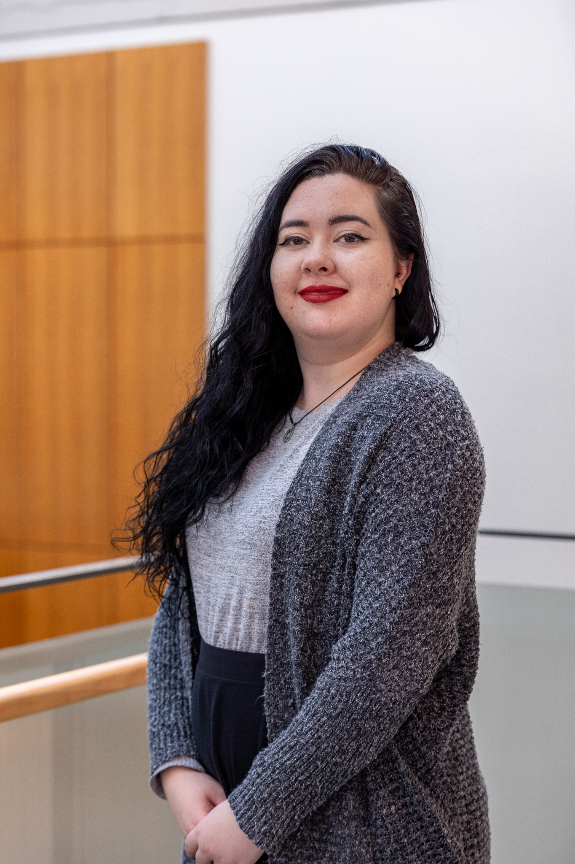
My Why: Positionality
Academic Background:
Bachelor of Science in Mathematics and Physics
Bachelor of Education with a focus on Universal Design and educational pedagogy,
A disability advocate across educational systems for more than 10 years:
Across levels, roles, locations and systems

Slide 4
Context: When Worlds Collide
Academia:
Knowledge Sharing
Implied Customs and Cues
How do you know who to go to when things go wrong?
The Disability Community:
Protect Your Own
Information Sharing is Advocacy
Who can you talk to when people don’t understand?
Accommodations?
Administrative Officials
Teaching Staff
Advocates and Support Staff
Students
Notes:
Context and Significance
The disabled community has its own information structures, communication styles, and risks that create a unique information culture characterized by protection and advocacy (Cole et al., 2011). When this world collides with the equally unique culture of academia, there is a profound disparity between the needs of disabled students and the support provided by the university accommodations system (Shpigelman et al., 2022). With the diverse life experiences of the different actors finding and sharing information that works within this system; including administrative officials, teaching staff, advocates and support staff, and students; each with their own set of resources, processes and abilities to access information to make decisions, and there is little understanding of the behaviors and perspectives of these actors and how their differences contribute to system disparities. Mixed-methods research into these overlapping worlds would provide the necessary data to ensure that university accommodations policies support an equitable, accessible society.
Disability with academia, don’t listen don talk, outline the four frames involved

Slide 5

We “need to strive for structural and holistic change in higher education policy and practice.” - Shpigelman et al., 2022
Students are struggling against stigma, identity politics, power structures, and even general barriers to access a post-secondary education, a fundamental human right.
Notes:
When these two worlds collide, there is little communication, and barriers related to the stigma around disability, the need to identify and out oneself, the power structures of academia and disabled people in society, and even unaddressed general access barriers are preventing disabled people from accessing a fundamental human right: access to post-secondary education. The system is broken and we need to do better.
Here is the kicker. We cannot do better unless academia is willing to hear what is wrong from the people being harmed. To truly be open to communication. That’s what this research is for: to act as a bridge between these two worlds, and to start mending the break to create a clear picture.

Slide 6

What To Do: Research Goals
Collect Narratives
What customs and actions make up the overlapping information frameworks used by the main actors in the academic accommodations information system?
Find the Gaps.
What disparities in understanding and information access exist between these actors?
Align the Frames
How the system can be adjusted and improved to remedy these disparities and better support a more inclusive accommodations system for post-secondary students with disabilities?
Notes:
Objectives and Research Questions
This research would aim to would map what constitutes the overlapping information frameworks used by the main actors in the academic accommodations information system, what disparities in understanding and information access exist between these actors, and how the system can be adjusted and improved to remedy these disparities and better support a more inclusive accommodations system for post-secondary students with disabilities. Answering these questions would provide insight into the lapses in information sharing and understanding between and within actor frameworks in order to improve and understand this world of information.
Collect narratives, find the gaps, improve the coherence, align the frames, support information use for student growth

Slide 7

Expected Methodologies: Mapping and Modelling
A Dalhousie University Case Study
Semi-structured Interviews across all four actor populations.
Information World Mapping narrative elicitation
A creative visual mapping exercise that focuses on participant viewpoint and understandings and centers equity-deserving narratives (Greyson et al., 2017).
Describe these Small Worlds
Use Chatman’s Small World Theory (1999) as a basis to describe information sharing and customs in closed systems
Quantitative Context
Use semantic distance in textual meaning to model quantitative error in the modelling.
Notes:
Methodology
This research project will use Dalhousie University as a representative case study. Gathering a sample of individuals via proportional stratified random sampling amounting to twenty percent of each of the above actor populations, data will be collected using semi-structured interviews. Within these interviews, the Information World Mapping elicitation method will be used to gather creative visual maps and verbal interpretations of information access. use and interactions in the university accommodations system (Leedy & Ormrod, 2015; Greyson et al., 2017). This method will allow for inclusive participation in this research by all actors, including disabled students, while maintain an in-depth understanding of the interactions and meaning-making of these main actors (Greyson et al., 2017).
By using the Information World Mapping elicitation method to authentically describe the post-secondary accommodations system according to the perceptions and experiences of the actors directly involved, a model of overlapping and disparate frames of information access and use could be created that would allow for an in-depth analysis of information use and its relationship to access for disabled post-secondary students (Greyson et al., 2017). By extending the model of unique closed systems of information customs and sharing described by Chatman’s Small World theory (1999) and using critical theory to understand this world, this research will analyse the qualitative data via textual analysis to provide insight into this small world of information (Leedy & Ormrod, 2015). Additionally, this qualitative data analysis will be extended using a combination of semantic distance, or similarity in meaning in text, combined with quantitative and statistical error analysis to gain a better understanding of textual analysis accuracy and reliability (Bedford & Gracy, 2014; Baird, 1995). Combining these methods will allow for deeper understanding of how information is shared and restricted in post-secondary accommodations systems, this providing more focused insights into potential improvements.

Slide 8

Research Significance and Community Connections
Look to the ripple effects: Using critical frameworks to extend Chatman’s Small World Theory (1999)
Extend textual analysis through the use of semantic distance to quantify error
Reduce the effort and barriers to narrative research in disabled communities
Notes:
In addition to building an in depth understanding of the systems of power and information interactions that support and impede the inclusion of disabled students in post-secondary settings, this research project will act to extend Small World theory using critical frameworks to better understand the impact of multiple actors within a closed information system, while also providing a proposed method for quantifying error in textual analysis via semantic distance to extend similar data analyses, all while looking for ways to make narrative collection more accessible and less taxing for disabled people (Chatman, 1999; Leedy & Ormrod, 2015; Bedford & Gracy, 2014, Greyson et al., 2017). In addition to contributing to the literature on disability and accessibility in post-secondary institutions, this research will also produce a professional, concrete set of recommendations to expand and improve post-secondary academic accommodations systems.

Slide 9

Conclusions: Why the How Matters
The need for advocacy and protection in diversity, inclusion and autonomy is at a high: these issues must be prioritized in systems that control new research and knowledge.
This cannot be done without an in-depth understanding of the inadequacies of the current university accommodations system for disabled students.
Notes:
In a time when advocating for diversity, inclusion and autonomy are at a high, there needs to be sufficient support for these values to be fostered in the post-secondary systems that control new research and knowledge systems (Waterfield & Whelan, 2017). This cannot be done without an in-depth understanding of the inadequacies of the current university accommodations system for disabled students. In bringing together concepts and experiences in disability advocacy with analyzing information systems and policies through their systems of information interaction and power structures, the research can improve the experiences of future disabled university students, while bringing in the use of quantitative error analysis to extend models of textual analysis to better represent margins of error in information systems research. My background and interests give me unique insight into this research that would allow for extended insight into this system. This work is imperative to creating an accessible and inclusive university system and completing this research through the perspectives of information systems and human interactions can provide a unique opportunity for a more equitable and accessible world of Canadian education and research.

Slide 10

Thank You
LinkedIn www.linkedin.com/in/ drew-f-9111a2306
Email Drew.Fitzgerald@dal.ca

Slide 11
References
Baird, D. C. (1995). Experimentation: an introduction to measurement theory and experiment design (3rd ed). Prentice-Hall.
Bedford, D. A. D., & Gracy, K. F. (2014). Comparative evaluation of three types of semantic distance metrics—Implications for use in semantic search. Qualitative & Quantitative Methods in Libraries, 1, 153–173.
Chatman, E. A. (1999). A theory of life in the round. Journal of the American Society for Information Science, 50(3), 207–217. https://doi-org.ezproxy.library.dal.ca/10.1002/(SICI)1097-4571(1999)50:3<207::AID-ASI3>3.0.CO;2-8
Cole, J., Nolan, Y., Seko, K., & Mancuso, A. (2011). GimpGirl grows up: Women with disabilities rethinking, redefining, and reclaiming community. New Media & Society, 13(7), 1161–1179.
Greyson, D., O’Brien, H., & Shoveller, J. (2017). Information world mapping: A participatory arts-based elicitation method for information behavior interviews. Library & Information Science Research, 39(2), 149–157. https://doi.org/10.1016/j.lisr.2017.03.003
Leedy, P. D. & Ormrod, J. E. (2015). Practical Research: Planning and Design (11th ed.) Boston: Pearson.
Shpigelman, C.-N., Mor, S., Sachs, D., & Schreuer, N. (2022). Supporting the development of students with disabilities in higher education: Access, stigma, identity, and power. Studies in Higher Education, 47(9), 1776–1791. https://doi.org/10.1080/03075079.2021.1960303
Waterfield, B., & Whelan, E. (2017). Learning disabled students and access to accommodations: Socioeconomic status, capital, and stigma. Disability & Society, 32(7), 986–1006. https://doi.org/10.1080/09687599.2017.1331838
All Images Sources from Pixabay Stock Photos
Title for X
What are the most important things that differentiates your subject or big idea…

